Slide 1

Project Title -Seasonal Agriculture Performance Analysis
[Student Name: Govindu Yaswanth Balaji
College Name- Sri Chundi Ranganayakulu Engineering College]
AICTE STU ID : STU684c1ba5539a51749818277

Slide 2

PROBLEM STATEMENT
Agricultural activities are influenced by seasonal variations in environmental conditions, farming practices, resource availability and market conditions. As a result, agricultural performance may differ from one season to another. However, raw agricultural data does not clearly explain how agricultural performance changes across seasons or what patterns can be observed in different seasonal conditions. The problem is to analyze the given agricultural dataset and investigate seasonal differences in agricultural performance by identifying meaningful patterns, trends, relationships and variations within the available data.
(

Slide 3
Project Description This project involved a comprehensive analysis of an agricultural dataset to uncover factors influencing crop yield and farm profitability. The primary objective was to provide data-driven insights and recommendations to optimize farming practices.

Slide 4

WHO ARE THE END USERS?
Farmers
Agricultural Policymakers and Government Agencies
Agricultural Researchers and Scientists
Financial Institutions and Insurers
Extension Services

Slide 5

Technology Used
Python
Google colab
Pandas
Numpy
Matplotlib
seaborn

Slide 6
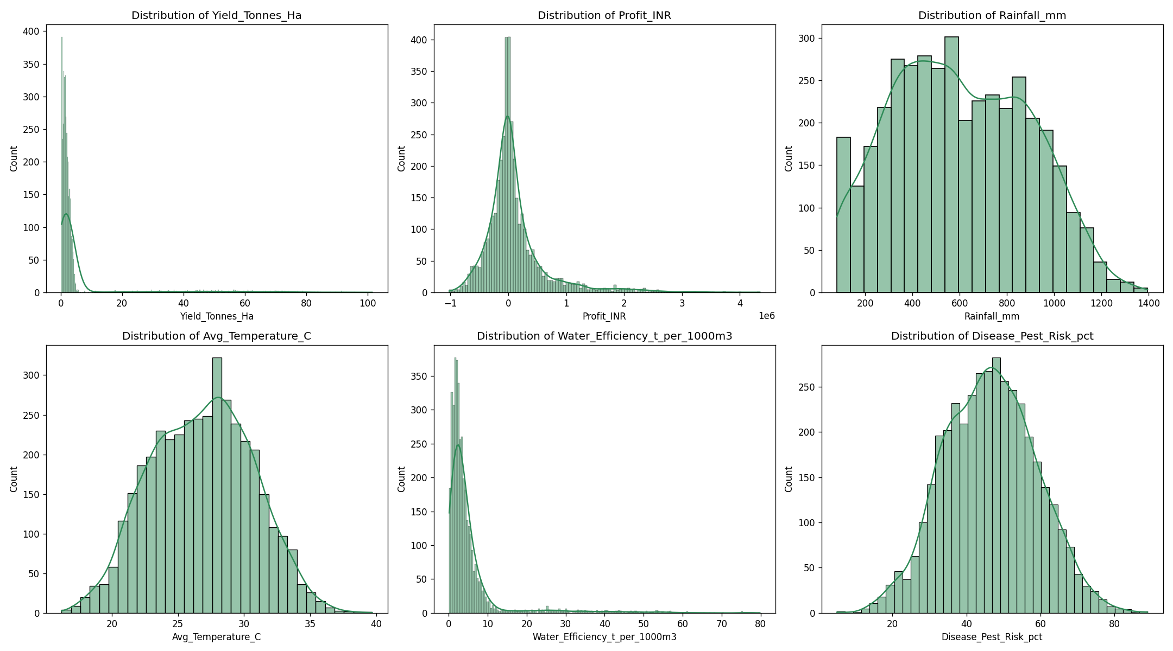
RESULTS
[Add screen shots of your code ]

Slide 7
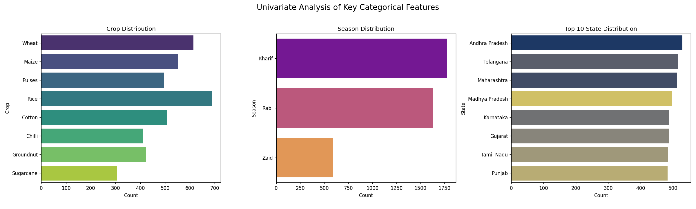
RESULTS
[Add screen shots of your code ]

Slide 8
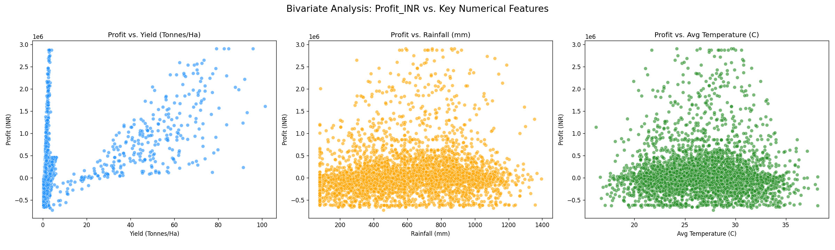
RESULTS
[Add screen shots of your code ]

Slide 9
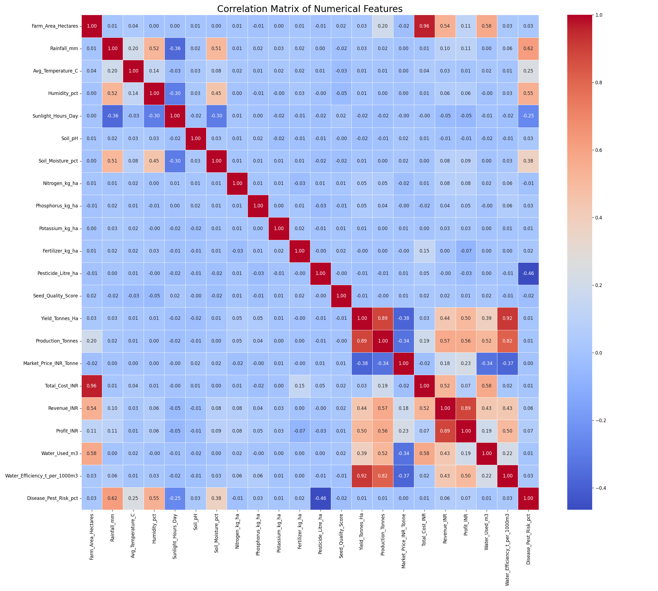
RESULTS

Slide 10
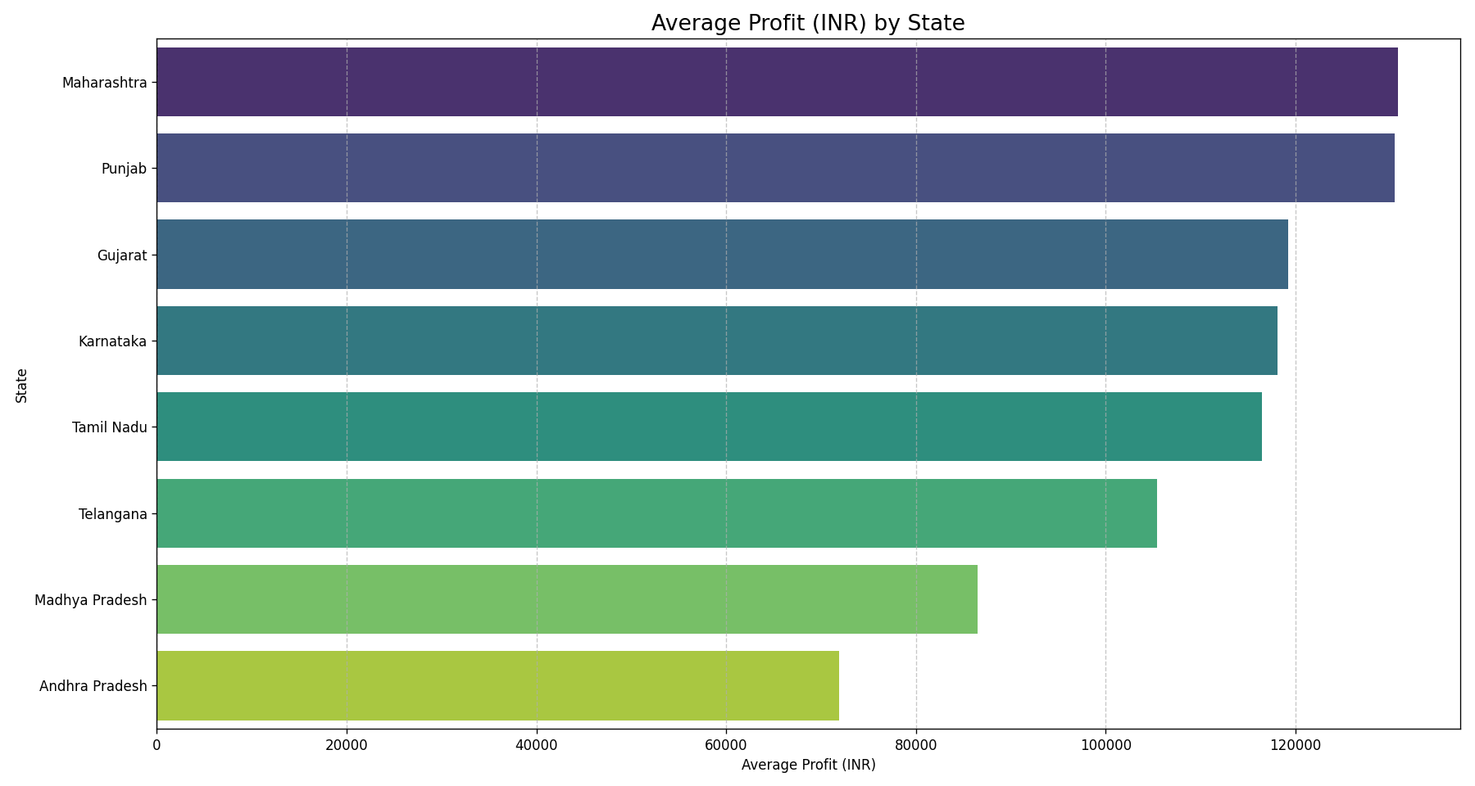
RESULTS
[Add screen shots of your code ]

Slide 11
Future scope
The future scope of this agricultural analysis could involve several key areas:
Predictive Modeling: Develop machine learning models to predict crop yield and profitability based on environmental factors, nutrient levels, and other agricultural practices. This could include forecasting optimal planting times and resource allocation.
Advanced Data Integration: Incorporate additional data sources such as real-time weather data, satellite imagery, soil sensor data, and market demand fluctuations to create a more comprehensive analysis.
Economic Impact Analysis: Conduct a deeper dive into the economic factors influencing farmer profitability, including supply chain dynamics, government policies, and global market trends.
Sustainability Assessment: Evaluate the environmental impact of different farming practices, focusing on water usage efficiency, fertilizer runoff, and pesticide impact to recommend more sustainable approaches.
Interactive Dashboard Development: Create an interactive dashboard (e.g., using tools like Tableau, Power BI, or even Python libraries like Dash/Streamlit) that allows farmers, policymakers, and researchers to explore the data and insights dynamically.
Regional Specifics and Micro-climates: Conduct more localized studies, analyzing data at a finer geographical granularity to account for micro-climates and specific regional challenges and opportunities.
Longitudinal Studies: Track agricultural performance over multiple years to identify long-term trends, the impact of climate change, and the effectiveness of sustained agricultural interventions.

Slide 12
GitHub Link
https://github.com/yaswanth-DA-108/Seasonal-Agriculture-Performance-Analysis

Slide 13

VOIS Course completion certificate - Course name- Data Visualization

Slide 14
Thank you
Thank You For the wonderful learning opportunity
.
.

